Slide 1

MANAGING DISRUPTIVE TECHNOLOGIES • ASSIGNMENT 4
Motion AI & Chatbot-Enabled CRM
Case Analysis & Strategic Presentation
Group 7
Delaney Wu, Jenny Suk, Brendan Reed, Zoe Liu

Slide 2
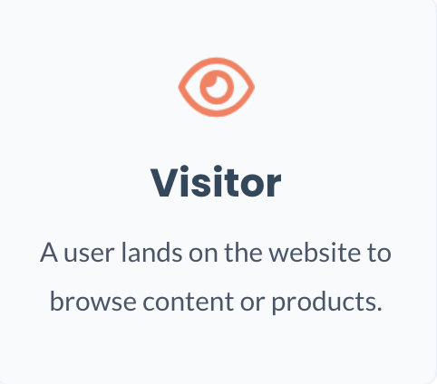
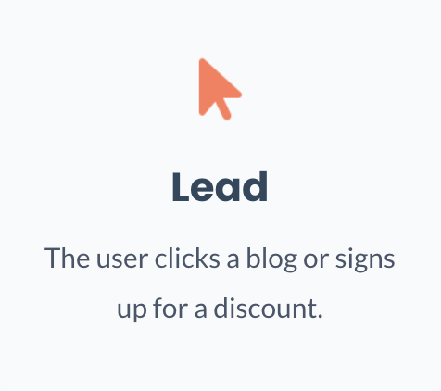
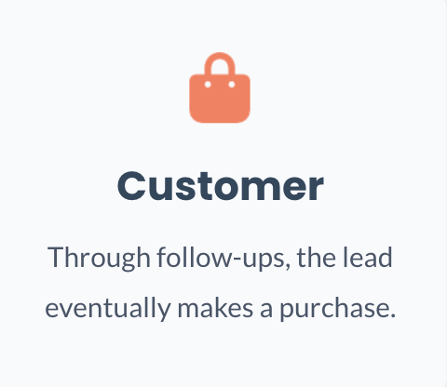
Who is HubSpot?
CRM & Marketing Platform
Designed specifically for SMBs to manage the entire customer journey.
Attract → Convert → Retain
Notes:
HubSpot is a CRM & Marketing platform and especially serves small & medium businesses. In more simple words, HubSpot is a platform that helps businesses turn website visitors into customers.
For example, imagine a small business selling skincare products online.
A user visits their website — this is a visitor.
They click on a blog or sign up for a discount — now they become a lead.
Then, through emails or follow-ups, they eventually make a purchase — becoming a customer. and ideally stay as a long-term customer.
HubSpot provides tools to manage and optimize this entire process, from attracting users to converting and retaining customers.

Slide 3
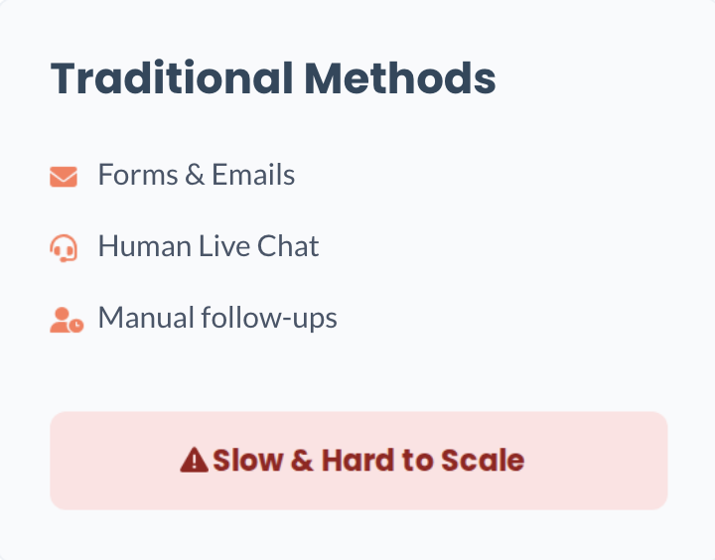
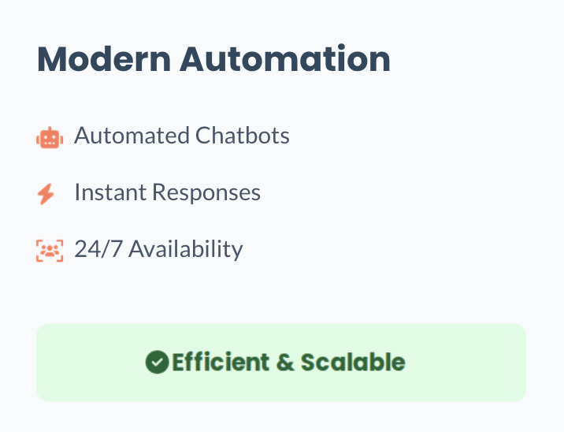
The Core Subject
Key Question: When should HubSpot use Chatbots vs. Human
Notes:
Traditionally, HubSpot relied on tools like forms, emails, and human live chat to interact with users. These were often slow and difficult to scale, especially for small businesses. So, HubSpot started exploring chatbots to automate and scale customer interactions.
But this leads to a key question:
when should firms use chatbots versus human interaction?

Slide 4
The Ultimate Challenge
How to balance Efficiency of automation with the User Experience and Trust of human interaction in platform design
Notes:
Chatbots improve efficiency, but they may also affect user experience and trust.
So the key challenge is how to balance efficiency and user experience in platform design.

Slide 5
Main Outcomes
Chatbots show high potential but are still immature
Bots struggle with complex, ambiguous, or context based conversations
Mixed customer/consumer preferences
The biggest challenge is not technical, but conversational
Notes:
Chatbots show high potential—they can provide fast, scalable, and cost-effective customer interactions. However, the technology is still relatively immature.
Bots continue to struggle with complex, ambiguous, or context-heavy conversations, which limits their ability to fully replace human interaction.
Customer preferences are mixed. While many users value the speed and convenience of bots, they still prefer human support when dealing with more complicated or nuanced issues. This creates a need for balance rather than full automation.
One of the most important insights is that the biggest challenge isn’t purely technical—it’s conversational. Designing effective, natural, and helpful interactions is difficult, and poor conversational design can quickly lead to frustration and damage the customer experience.
Overall, the case shows that success with chatbots depends less on the technology itself and more on how thoughtfully it is implemented.

Slide 6
Strategic Takeaways
The most optimal strategy is to use a hybrid model (human + bot)
Prioritize customer experience over efficiency
Be transparent and manage brand risk
Balance short-term efficiency with long-term relationships

Slide 7
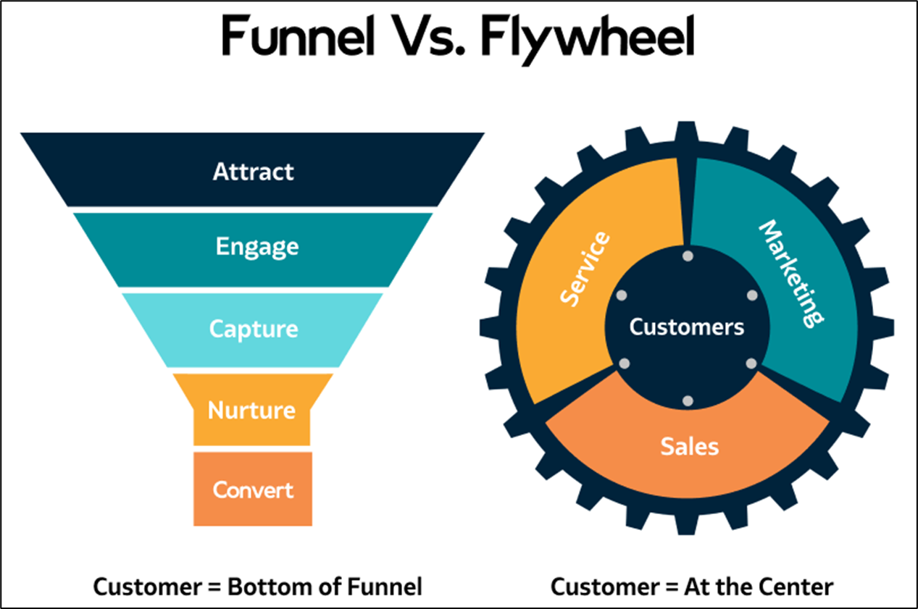
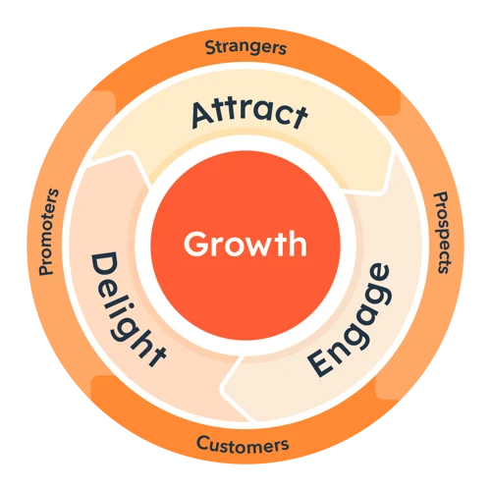
HubSpot’s pioneer of the Flywheel Model:
HubSpot’s Flywheel places customers as the driving force that fuels growth and acts as the backbone.
The industry as a whole has since begun switching from funnel to flywheel.
AI serves as the "rotational energy" for the flywheel, leveraging data-driven network effects to turn every captured interaction into intelligence.
Attract
Engage
Delight
Notes:
Brendan.

Slide 8
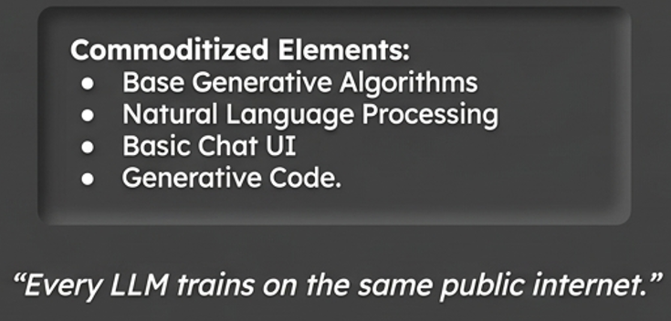
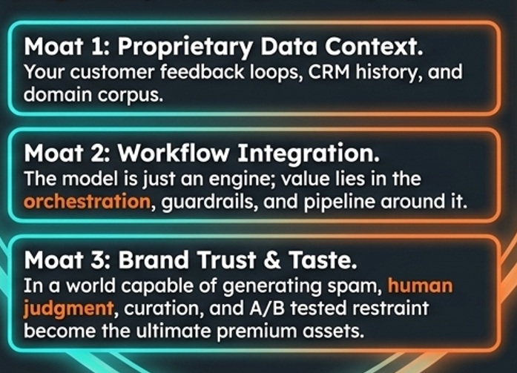
Industry shift to data-dependent moats:
HubSpot identified early on; the baseline dependency of data available in traditional LLM’s does not achieve a competitive advantage. Their creation of the “data moat” attempts to overcome this.
HubSpot’s "Conversations" tool collects customer data across Facebook, email, and web chat into one inbox, creating a proprietary and sustainable feedback loop that fuels its AI.
Commoditized data:
Un-commoditized data:
Notes:
Brendan.

Slide 9
Current-Day Implications: Why HubSpot Is Winning in the AI Era
Old CRM advantage
Scale
Installed base
Large sales teams
Product breadth
New AI-era CRM advantage
Unified customer data
Cross-functional integration
AI-assisted workflows
Lower-friction user experience
Notes:
Traditionally, CRM companies competed based on scale. The biggest advantage came from having the largest installed base, the biggest sales force, and the broadest set of products. Today, that is changing in the AI era.
Today, the most valuable asset is unified customer data. AI is much more effective when a company can see the entire customer journey in one system.
That gives HubSpot an advantage because its marketing, sales, support, email, and chat tools are all integrated into one platform.
For example, if a customer downloaded an ebook, opened a sales email, contacted support, and used live chat, HubSpot can connect all of those interactions into a single profile.
That creates three advantages.
First, it improves AI accuracy because the system has more context.
Second, it creates smoother handoffs between teams because sales, marketing, and support all see the same information.
Third, it creates a lower-friction customer experience because customers do not have to repeat themselves across different channels.
So, while older CRM competition was based on scale, the new source of competitive advantage is integrated data and AI-enabled workflows.
That shift is one reason HubSpot has become much more competitive relative to larger firms like Salesforce, which will be discussed in further detail on the next slide.

Slide 10

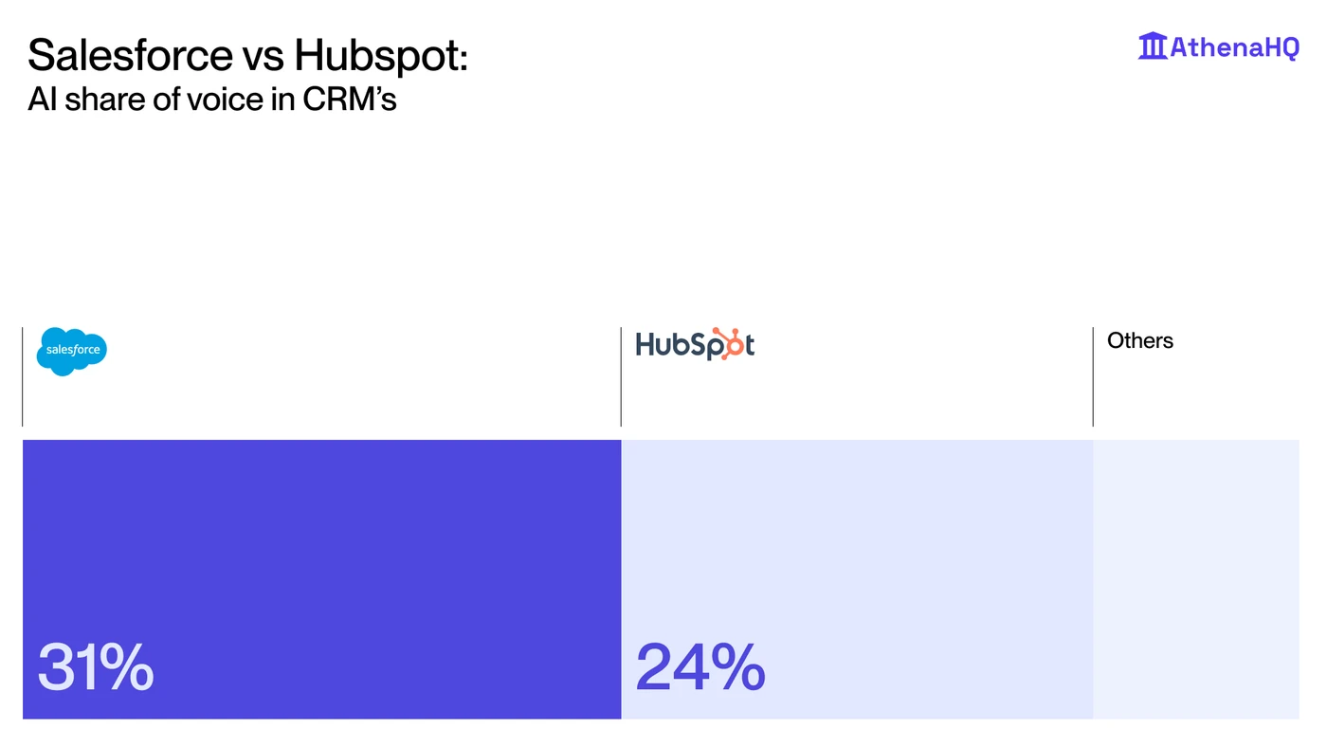
HubSpot’s disruption of :
HubSpot has rapidly caught up in the AI-era due to Salesforce’s long criticized data fragmentation.
HubSpot acquired Motion AI to add new capability to its unified platform.
Whereas Salesforce's history of buying separate companies has created disconnected data silos that made their information less useful.
Commonly referred to as “integration debt”.
Notes:
Brendan.

Slide 11
References
9 CRM trends for 2024. (n.d.). CIO. https://www.cio.com/article/1255983/customer-relationship-management-crm-trends.html
Customer Relationship Management Market Size, Share | Growth, 2027. (n.d.). Www.fortunebusinessinsights.com. https://www.fortunebusinessinsights.com/customer-relationship-management-crm-market-103418
HubSpot and Motion AI: Chatbot-Enabled CRM - Case - Faculty & Research - Harvard Business School. (n.d.). Www.hbs.edu. https://www.hbs.edu/faculty/Pages/item.aspx?num=53650
News, T. (2026, April). Market Overview & Definition The Customer Relationship Management (CRM) market plays a vital role in helping organizations manage customer interactions, streamline processes, and improve profitability. A comprehensive CRM market overview highlights its growing importance in today’s data-driven busin. Linkedin.com. https://www.linkedin.com/pulse/customer-relationship-management-crm-3lkrc
Technavio. (2024). Crm Market Analysis North America, Europe, APAC, South America, Middle East and Africa - US, Canada, UK, Germany, Japan - Size and Forecast 2024-2028. Technavio.com. https://www.technavio.com/report/crm-market-industry-analysis
Frends iPaaS. (2025, November 5). Integration debt: The silent threat holding back digital transformation. Frends.com; Frends Technology. https://frends.com/insights/integration-debt-the-silent-threat-holding-back-digital-transformation
Gillen, P. (2026, April 14). SiliconANGLE. SiliconANGLE. https://siliconangle.com/2026/04/14/hubspot-targets-ai-driven-buyer-behavior-shift-new-tools-agents/
HubSpot. (2018). The Flywheel Model. Hubspot.com. https://www.hubspot.com/flywheel
Salesforce Marketing Cloud Engagement vs HubSpot. (2024). Hubspot.com. https://www.hubspot.com/comparisons/salesforce-marketing-cloud-vs-hubspot-marketing-hub

